Slide 1



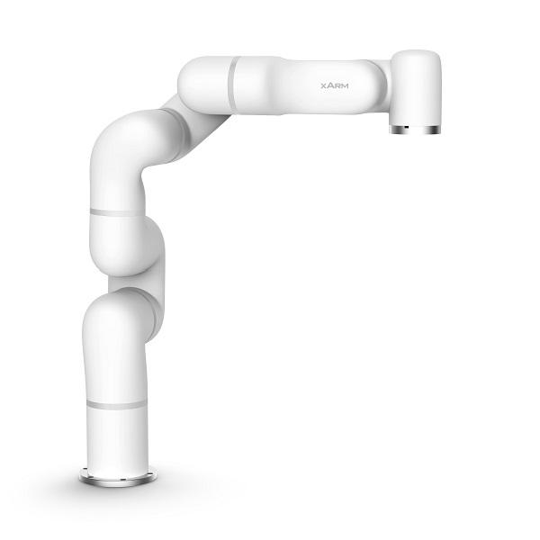
Introduction to ROS
How to use robot manipulators in ROS

Slide 2
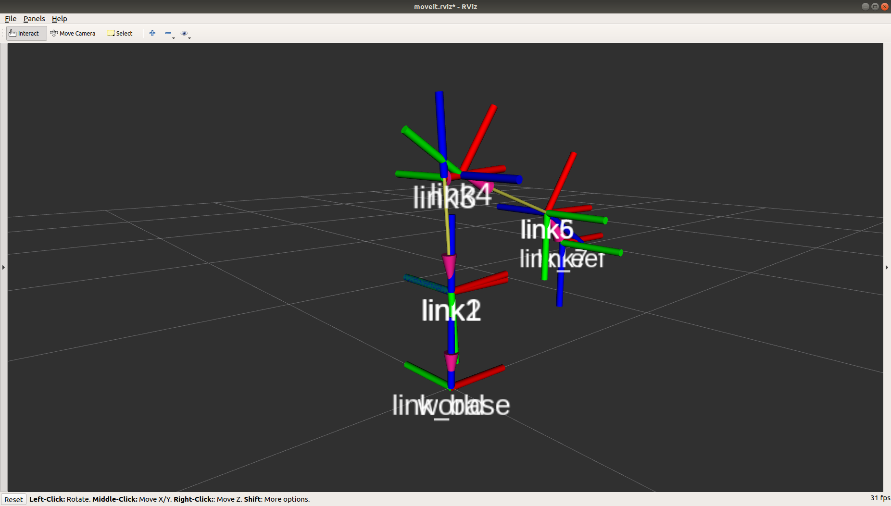
tf2 Introduction
”tf2 maintains the relationship between coordinate frames in a tree structure buffered in time, and lets the user transform points, vectors, etc between any two coordinate frames at any desired point in time.”
Notes:
Talk through the purpose of tf2

Slide 3
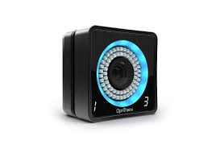
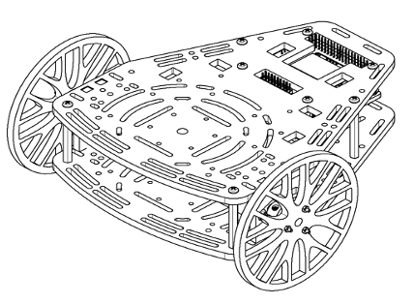

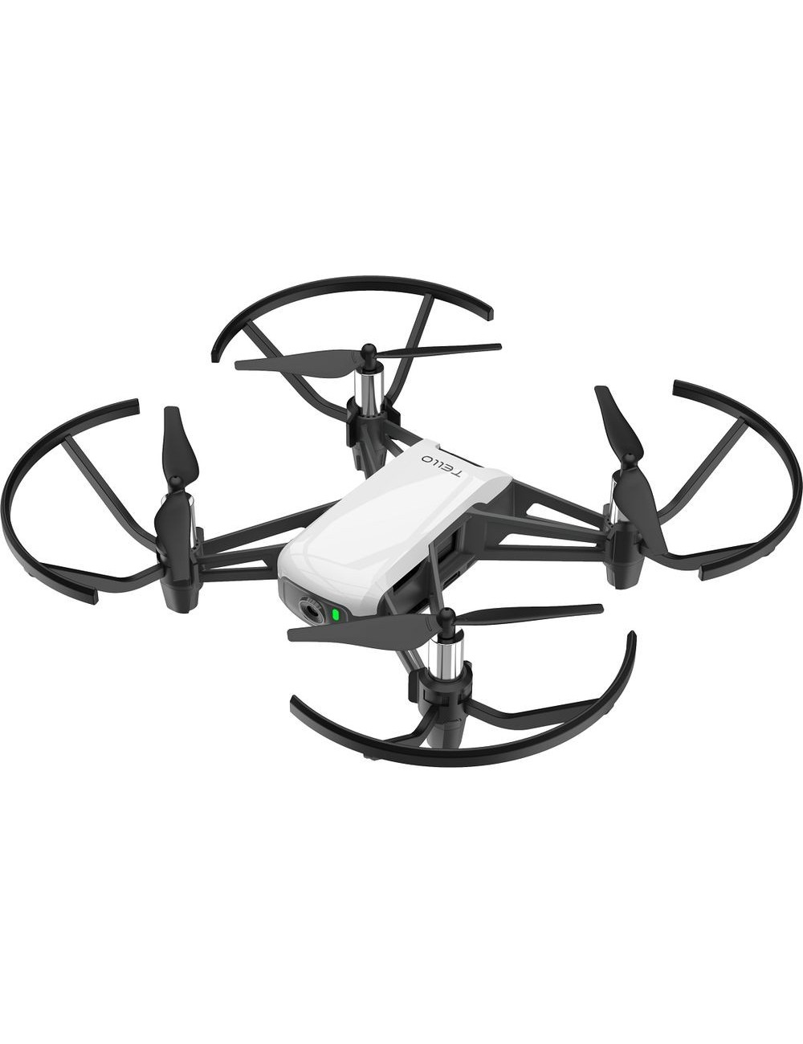
tf2 Concept
Common reference frame
Vision
Other robots
Manipulator
Notes:
Relate to a real scenario

Slide 4
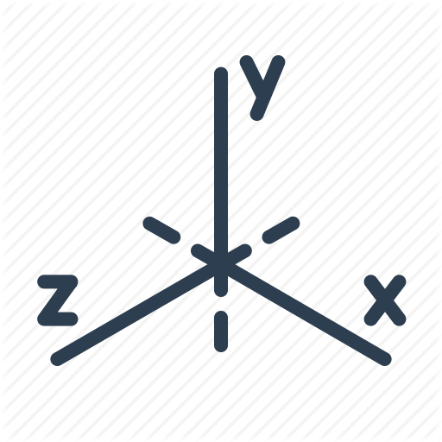
tf2 Static vs dynamic transform
Static Transform
Meant to be used to define transformations that are not going to be changing during the operational time.
Dynamic Transform
Used in scenarios where the relative position of the frame changes over time and needs to be updated
tf_static topic
tf topic
tf₀
tf₀
tf₁
tf₂
Notes:
Explain different types of transform

Slide 5
tf2 Computing a transform
# Initialize objects to store the transforms on them
self.tfBuffer = tf2_ros.Buffer() self.listener = tf2_ros.TransformListener(self.tfBuffer)
# Compute the transform between two frames at a given time
self.tfBuffer.lookup_transform("link_eef",data.frame,rospy.Time(),
rospy.Duration(0.5))
The Buffer object is used as a container for Listener to allocate the information retrieved from the function lookup_transform. In order to compute a transform, we need to provide the function with two frame names, destination and source, a time at which the transform is recorded and a time out. You can retrieve the transform between any two frames that can be connected though a tree.

Slide 6
tf2 Sending a transform
# Populate the vector with the transformation of the system
t = TransformStamped() t.header.stamp = rospy.Time.now() t.header.frame_id = "sensor_frame" t.child_frame_id = "goal" t.transform.translation = ”some_translation" t.transform.rotation = ”some_rotation"
# Input the transformation into the system
br = tf2_ros.StaticTransformBroadcaster() br.sendTransform(t)
# Input the transformation into the system
br = tf2_ros.TransformBroadcaster() br.sendTransform(t)
In order to send any transform within ROS the format of the transform must be TransformStamped(), which contains both a temporal reference and the transform object. Once the transform is defined it can be sent either as a static or dynamic transform by calling the appropriate sendTransform function from the broadcaster class.

Slide 7
tf2 Debugging tools
The main tools used to analyze tf2 behavior are
Command line tools
rosrun tf2_tools view_frames.py
rosrun tf2 tf2_monitor turtle2 turtle1
rosrun tf tf_echo [base] [target]
RQT_tree: A graphical representation of all the relationships within the network
RVIZ: The temporal evolution of each transformation can be displayed in real time.
Broadcasting transforms in your launch files

Slide 8
tf2 Timing Concerns
Tf2 keeps track of the status of the system through time. It is very important to populate the header files to keep temporal relationships correct.
try: past = rospy.Time.now() - rospy.Duration(5.0) trans = tfBuffer.lookup_transform_full( target_frame = ‘robot1', target_time = rospy.Time.now(), source_frame = 'carrot1', source_time = past, fixed_frame = 'world', timeout = rospy.Duration(1.0) )
tf2 allows to compute the spatial distance in terms of translation and rotation between two frames in difference instances of time. In this example the position of ‘robot1’ in time t is expressed with respect 'carrot1’ in time t-5, considering 'world’ as a fixed frame maintaining its position between both time instances.

Slide 9
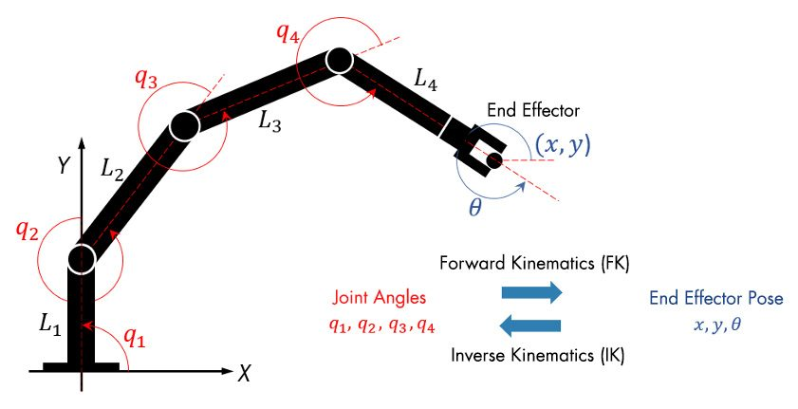
Xarm Model of a robotic arm

Slide 10
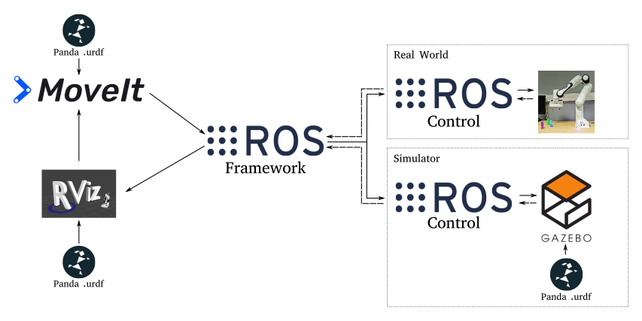
MoveIt! Introduction

Slide 11
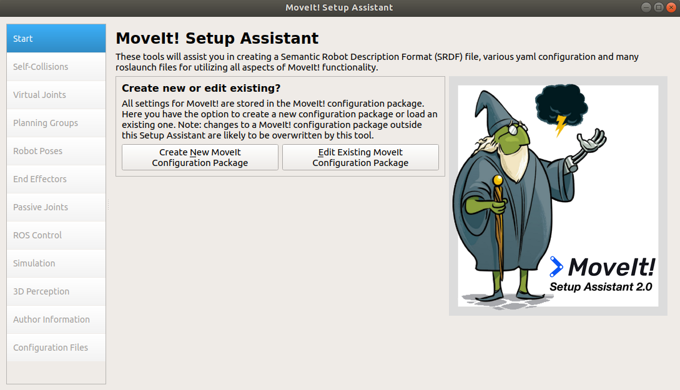
MoveIt! Set Up
This wizard generates the planner code so that any manipulator can be commanded easily in ROS, either in simulation or in real life.

Slide 12
MoveIt ! Wizard Summary
Load urdf models into the planner
Create or modify config packages created for a given robot
Add self collisions between links
Manage how links interact with each other
Add virtual joints to link the world with the robot framework
Use auxiliar joints to relate the robot with the rest of the world
Add planning groups
Divides the joints in groups for the planner to use when generating a path
Add passive joints
Defines non-actuable joints
Add controllers
Attaches ROS controllers to each of the joints
Input 3D information of the environment
You can add depth sensors to detect obstacles that need to be avoided by the arm

Slide 13
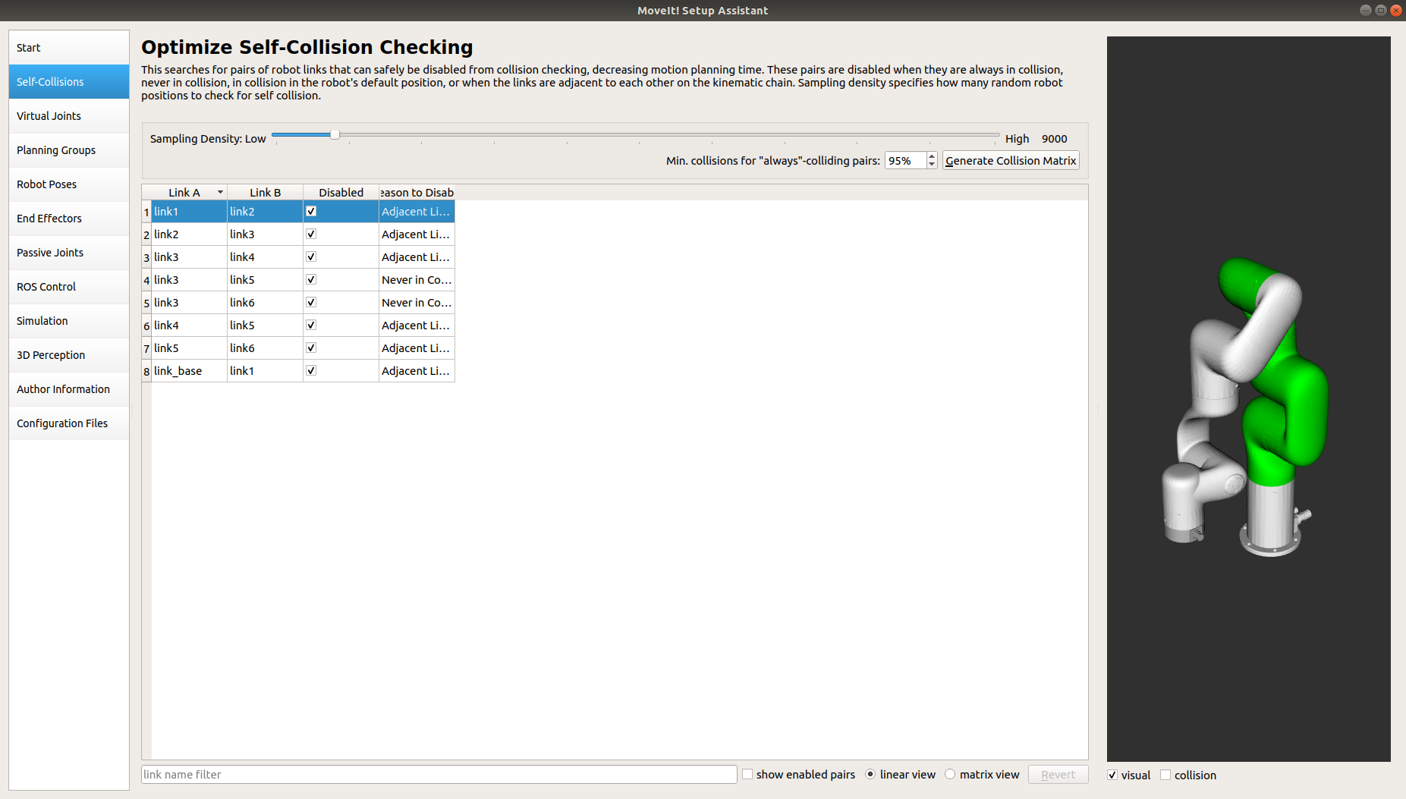
MoveIt ! Wizard Self-Collision
This set of options is used to prevent unnecessary collision simulation between links and avoid unrealistic collisions. For example, if two links are in contact, we don’t want our planner to treat it as a collision and thus it is included in this list.

Slide 14
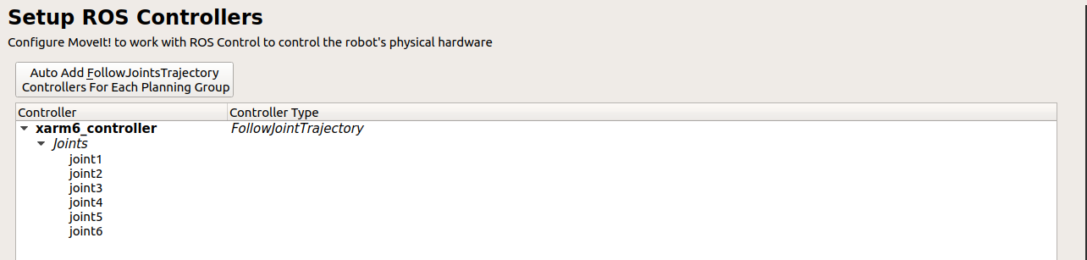
MoveIt ! Wizard Controllers
Screen devoted to add controllers to the joints of your robot. You already know how to do it working directly with urdf files, but it may be convenient to do it directly from this menu.

Slide 15
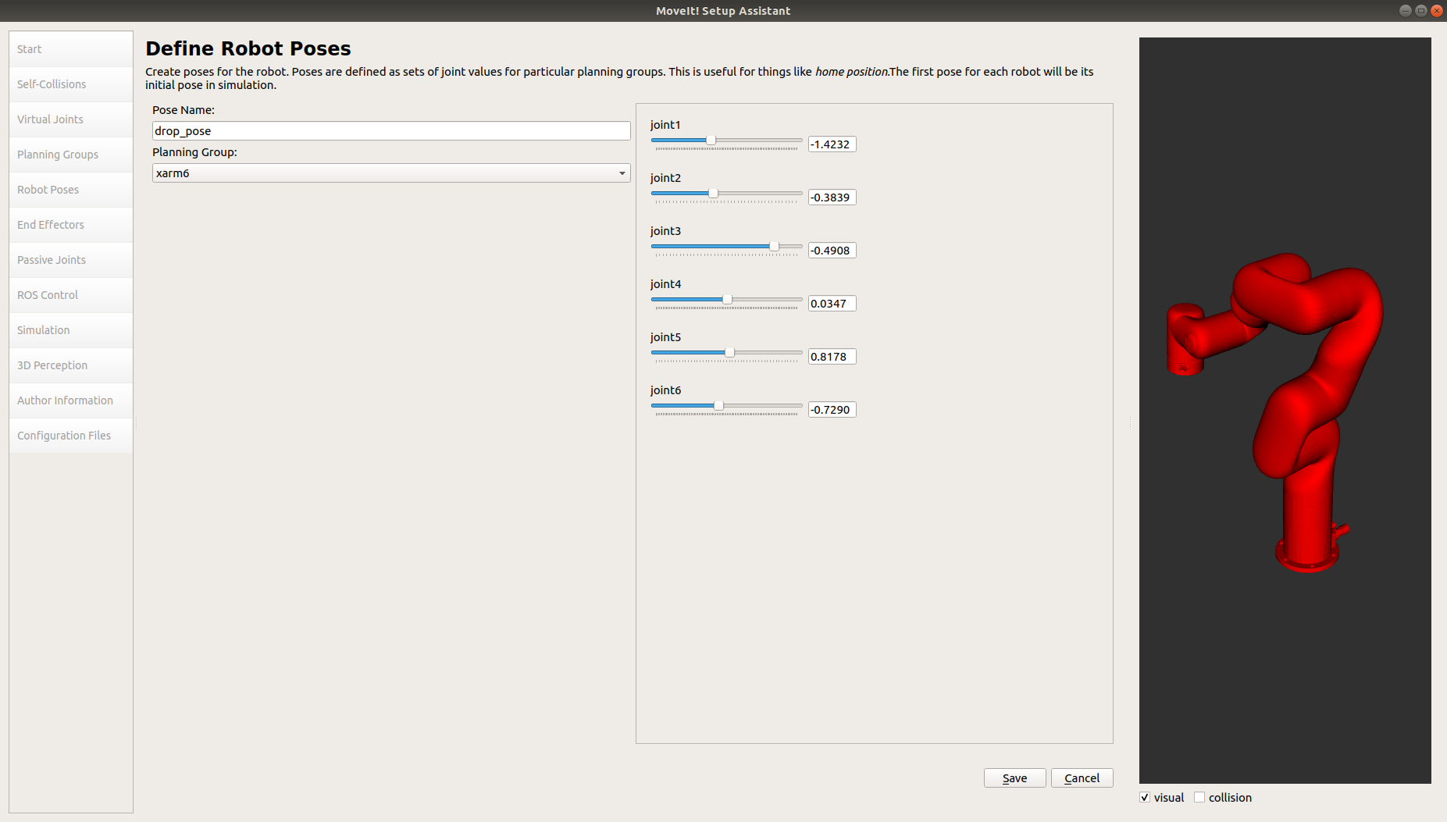
MoveIt ! Wizard Robot Poses
This screen is used to preprogram poses in the planner. If you plan to travel to the same position repeatedly it is easier to encode it once and then access to it without using by its keyword.

Slide 16
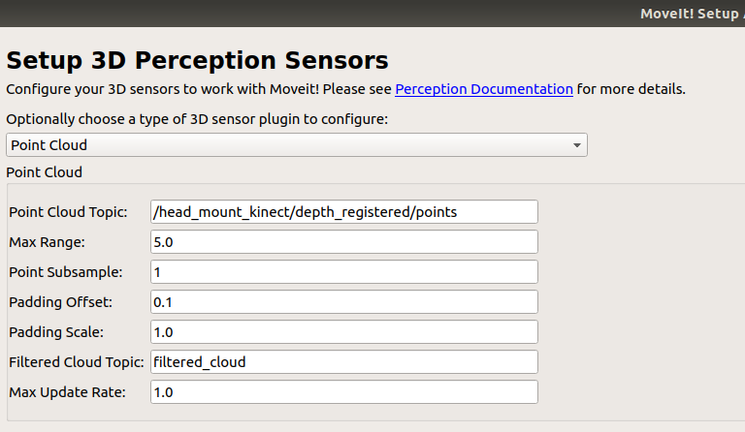
MoveIt! Wizard Perception
You can include perception to you planner by linking either a point cloud or a 3D camera. In that case obstacles detected will be represented as voxels in the planning space. Any plan derived will avoid those obstacles.

Slide 17
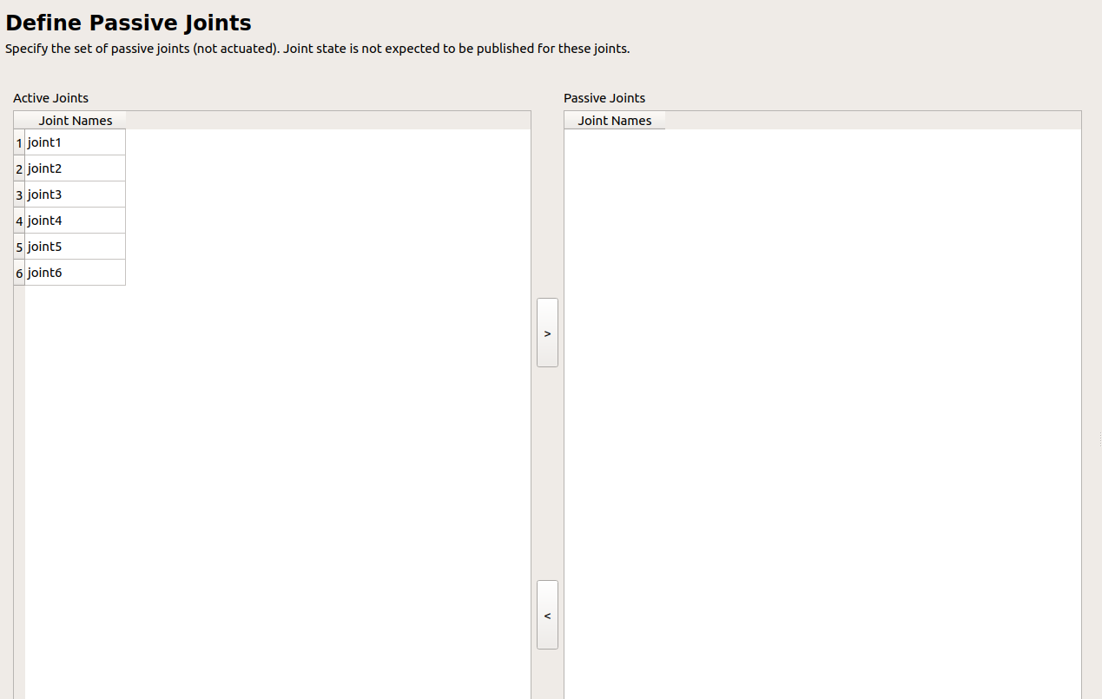
MoveIt! Wizard Passive Joints
Passive joints are used to define non-actuated joints, which are not associated to any actuator. In that case the planner will consider the presence of that joint to derive paths and simulate its behavior, but won't provide control actions for them.

Slide 18
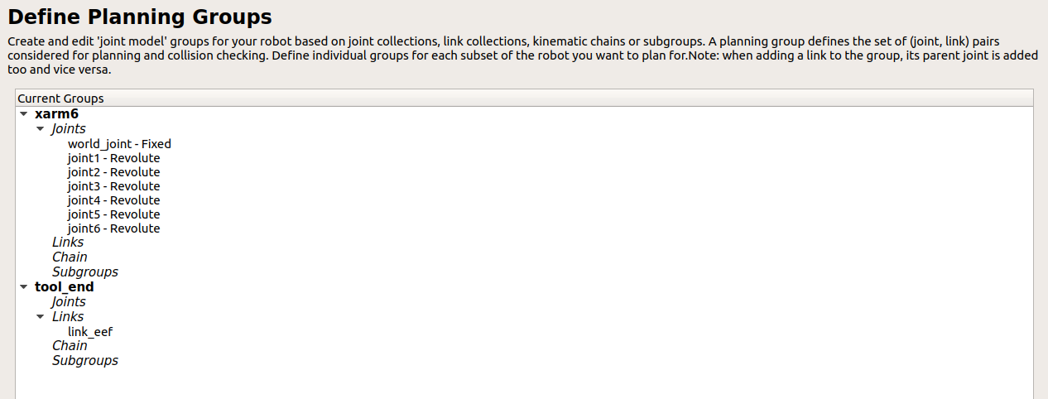
MoveIt! Wizard Plan Groups
MoveIt! Allow subdivisions of joints into groups so that you can plan movements affecting only a subset of the robot, diminishing the computational time. It is common to, at least, define two subgroups so that arm and tool can be used independently.

Slide 19


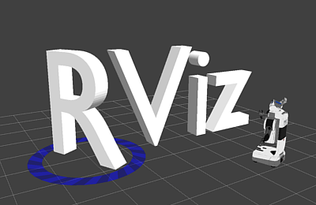


MoveIt! Rviz Interface
Most of the tools available in MoveIt can be applied to either real or simulated robot by sending commands through a visual interface coded in Rviz.
It is recommended to code your applications but is useful to test some of the movements beforehand.

Slide 20
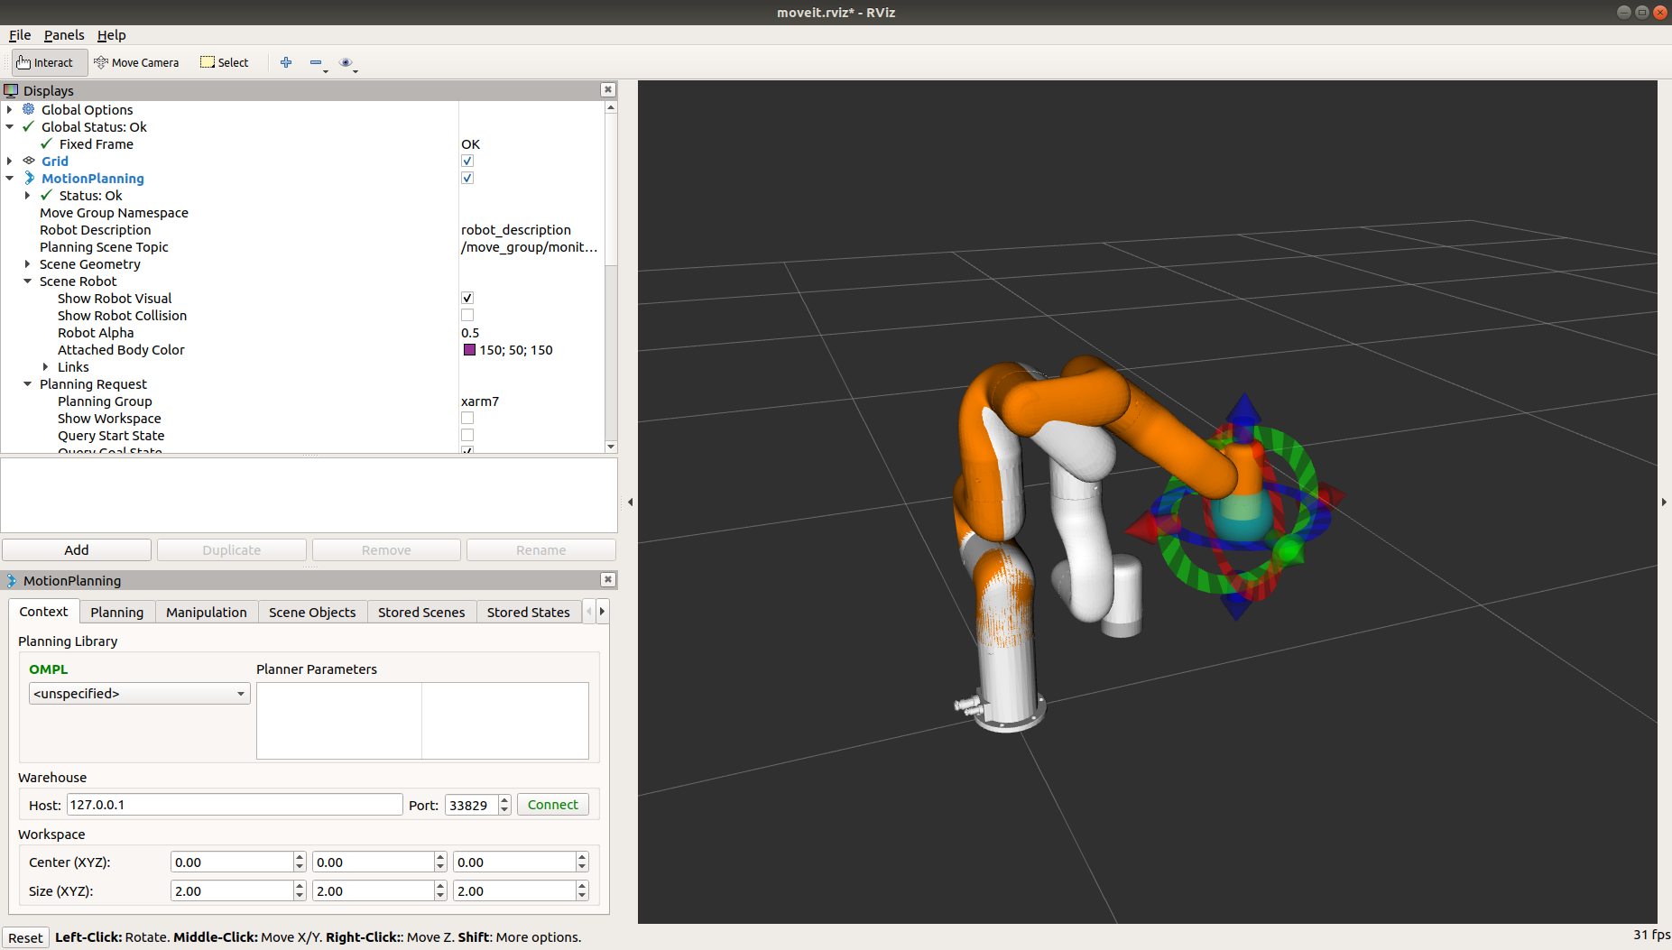
MoveIt! Rviz Interface
API to plan an execute movements though a user interface based on RVIZ.
Allows to configure different planning algorithms to drive the robot through the scene.
Tool to use the robot without having to code, only using visual tools.

Slide 21
MoveIt! Rviz Interface
Main window of the API, allows setting up the connection to a real robot, configure the planner by choosing from a list of available algorithms and set up the center of a workspace.

Slide 22
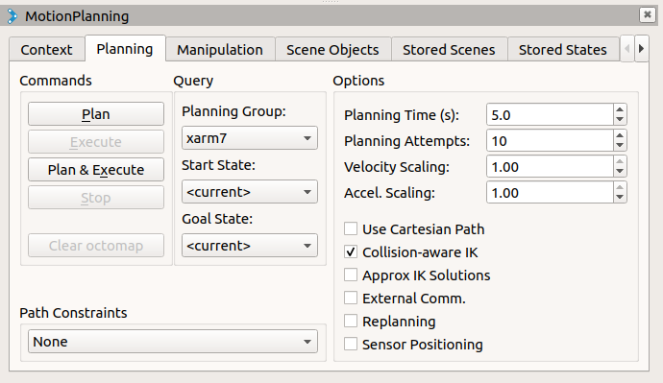
MoveIt! Rviz Interface
The ”Plan” window is used to limit some aspects from the planner, to adapt its performance to the needs of the user. Once the planner is set up you can either plan or execute a path for any of the groups defined in the set up step.

Slide 23
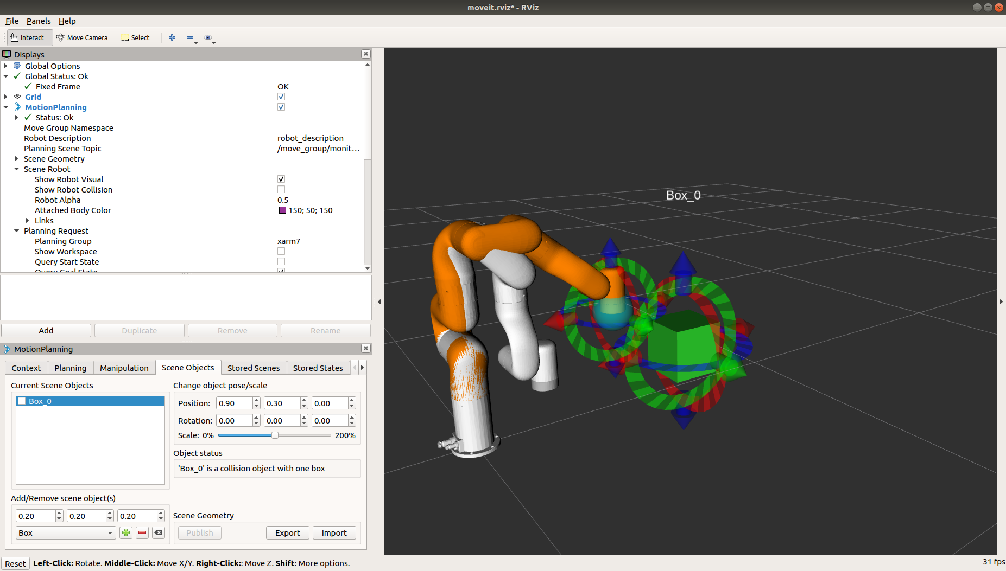
MoveIt! Rviz Interface
This window allows to place obstacles within the navigation space. Similarly, to what we’ve already seen in the setup phase, this option creates areas in the space that are avoided by the planner.

Slide 24
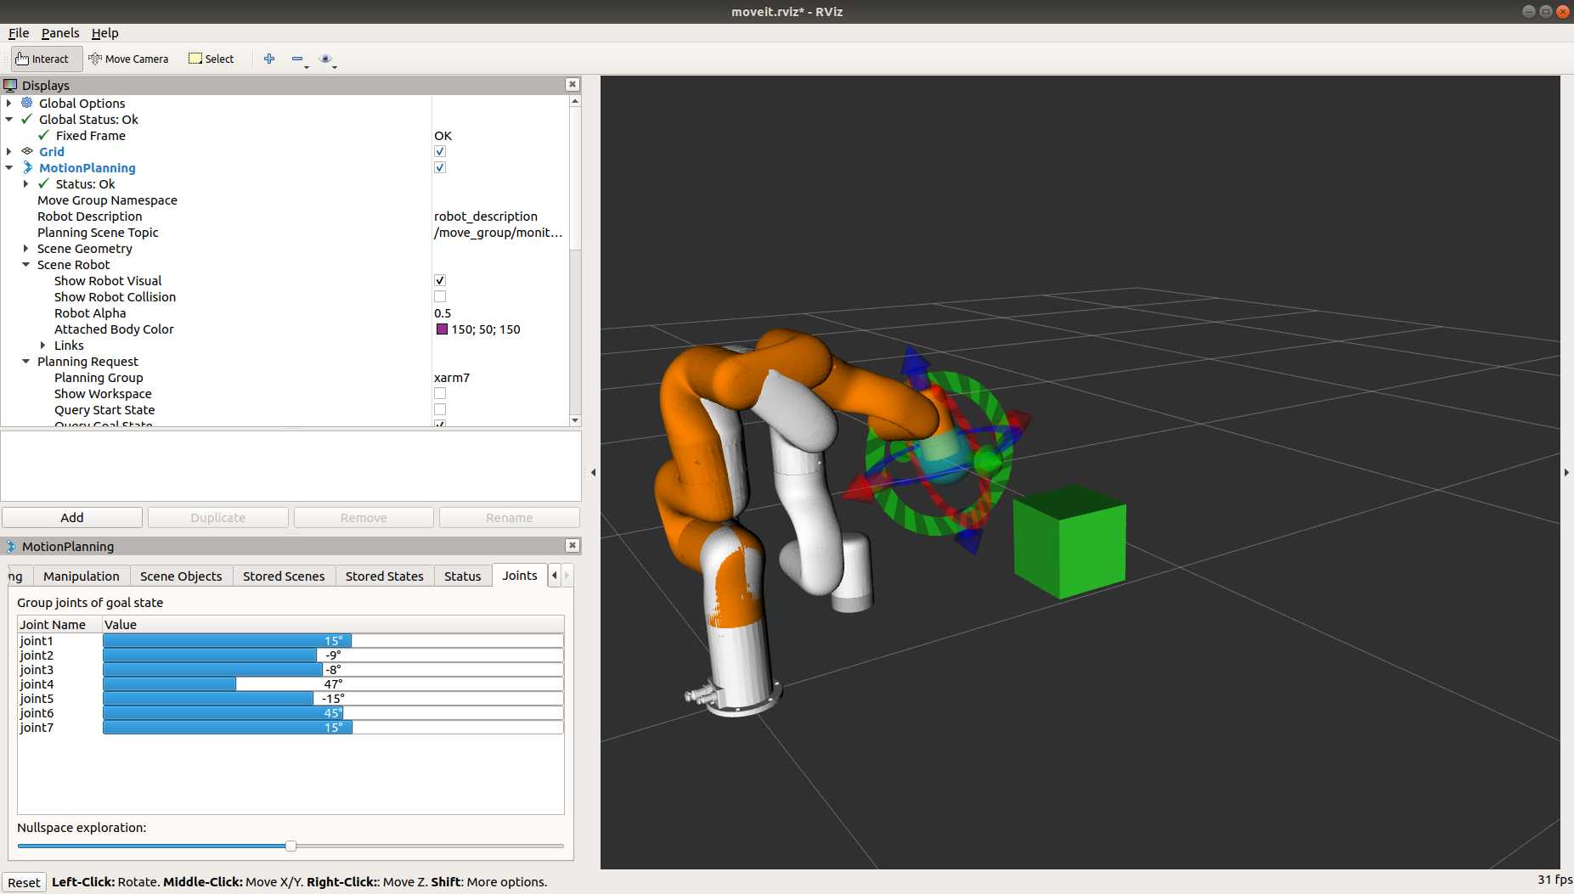
MoveIt! Rviz Interface
Menu used to set the value of any joint within the current operational group to a given value. It also allows to set up the value at which the null space is explored, which refers to the number of redundant positions that are explored.

Slide 25
Activity Controlling the robot through the interface
Run the Rviz interface using the package generated in the previous activity.
Using the appropriate commands, navigate through the environment and check that the plans avoid the highlighted area.
Rviz Interface
World

Slide 26
MoveIt! Python API
Move It! Is a set of tools used to easily integrate path planning with robotic manipulators. Originally, the library is written in Cpp but there’s a Python integration that maps the functions that are commonly used by standard users.
You can access most of the configuration tools available by MoveIt, however the specific parameters, sometimes dangerous for an untrained user, can only be changed used the original Cpp API.
Extensive documentation can be found in
http://docs.ros.org/en/melodic/api/moveit_tutorials/html/index.html
https://github.com/ros-planning/moveit

Slide 27
MoveIt! Python API
class Planner(): def __init__(self): moveit_commander.roscpp_initialize(sys.argv) self.robot = moveit_commander.RobotCommander() self.scene = moveit_commander.PlanningSceneInterface() self.group = moveit_commander.MoveGroupCommander("xarm7") self.link_ee = self.group.get_end_effector_link()
When coding with Move It! we need to consider three objects. Firstly, the RobotCommander, which controls the commands that are send to the arm. Secondly, the PlanningSceneInterface, which models the environment at which the plans will be derived. Finally, we need to take into account which group is going to be considered to derive a plan.

Slide 28
MoveIt! Move
def goToPose(self,pose): self.group.set_pose_target(target) self.group.go(wait=True) self.group.stop() self.group.clear_pose_targets()
def go_to_joint_state(self): joint_goal[0] = [0,0,0,pi/2,0,pi/4,0] self.group.go(joint_goal, wait=True) group.stop()
In order to send the robot to a desired pose we need to set it as a target and call go, blocking the code until the target is achieved. As a good practice is recommended to stop the robot and clean the current target afterwards.
Alternatively, you can drive the robot by setting a set of joint angles, and the planner will derive a suitable path and execute it.

Slide 29
MoveIt! Add Obstacles
def add_box(self): box_pose = geometry_msgs.msg.PoseStamped() box_pose.header.frame_id = "link_tcp”
# Populate the vector with the position of the obstacle box_pose.pose.orientation.w = 1.0
# Add the box to the scene self.scene.add_box("box", box_pose, size=(0.1, 0.1, 0.1))
def remove_box(self): self.scene.remove_world_object(box_name)
We can add obstacles to the environment by defining the position of and the shape of the object, either using a predefined shape (box, sphere or cylinder) or a custom 3D shape. In this case on of the predefined shapes is used to represent an obstacle that will be avoided by the planner.
Once the obstacle is not in the environment anymore we can remove it using the tag associated to it.

Slide 30
MoveIt! Attach and detach
def attachBox(self,box_name): grasping_group = 'vacuum_gripper' touch_links = self.robot.get_link_names(group=grasping_group) self.scene.attach_box(self.link_ee, box_name + "_planner", touch_links=touch_links)
Sometimes the robot will be carrying some cargo, for instance when executing a pick and place. In those cases, both cargo and robot becomes a unique element for the planner, as trajectories have to be non-colliding considering both objects. In order to
def detachBox(self,box_name): self.scene.remove_attached_object(self.link_ee, name=box_name)
Once the cargo is no longer attached to the end effector we need to tell the planner that it shouldn’t consider anymore.

Slide 31
MoveIt! Generate plans
def plan_cartesian_path(self, eef_step,jump_th ,waypoints):
(plan, fraction) = group.compute_cartesian_path(waypoints,eef_step,jump_th)
Cartesian path
Compute a sequence of waypoints that make the end-effector move in straight line segments that follow the poses specified as waypoints. The resulting path has a point every eef_step (m) with a maximum distance jump of jump_th (m). The return value is a tuple containing a fraction of how much of the path was followed and the actual plan.

Slide 32
Activity Pick and Place
Load the gazebo world that we provided to you
Make a pick-and-place application, moving each object to the container with the matching color.
Python Code

